Slide 1
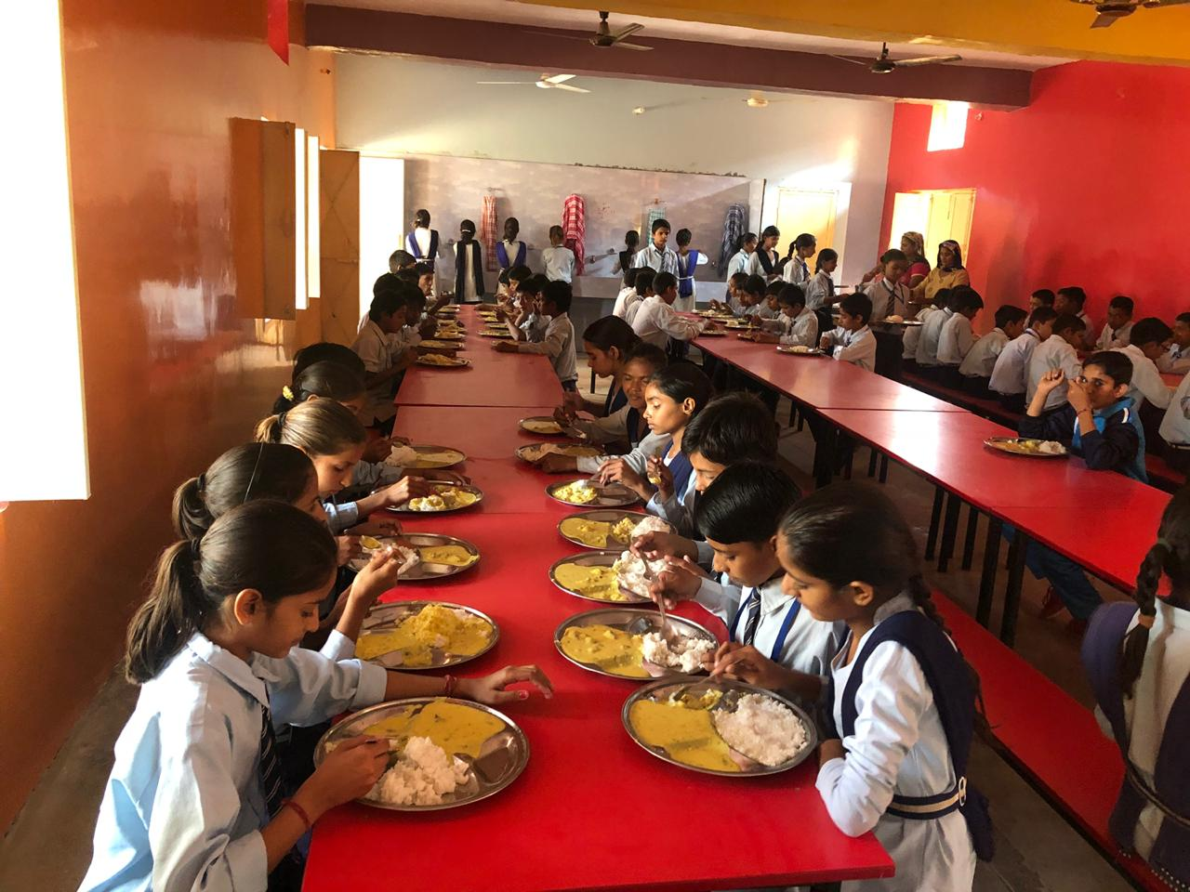
MID DAY MEAL SCHEME GOVT.OF HARYANA
ANNUAL WORK PLAN & BUDGET 2018-19

Slide 2
STRUCTURE OF PPT
Section I- Background
Section II- Count of Children & Institutions
Section III- Allocation & Utilization of funds
Section IV- Achievements
Section V- Review of assurance given in PAB 2018-19
Section VI- Monitoring Report
Section- VII- Joint Review Mission
Section- VIII-Proposal of funds for the year 2019-20

Slide 3
BRIEF NOTE - MID DAY MEAL SCHEME
Dry ration was distributed to the children before 2004.
Serving of cooked food was started in all Government schools, Local bodies, Government aided primary schools from 15.08.2004 onwards.
The scheme was further extended to all middle schools during the academic year 2008-09.
Objectives:
To attract Out-of-School Children (OoSC).
To retain the in-school children.
To improve the health of students.
Norms:
To provide 450 calories of energy/100 gms. of food grains to primary students.
To provide 700 calories of energy/150 gms. of food grains to upper primary students.
To provide 20 gms/ 30 gms proteins respectively to primary and upper primary students.
Cooking Cost :
Components of cooking cost include pulses, vegetables, cooking oil and fuel.
Rs. 4.35 for every primary student and Rs. 6.51 for every upper primary student has been provisioned toward cooking cost.

Slide 4
MANAGEMENT STRUCTURE
Additional Chief Secretary School Education
Director Elementary Education
Additional Director Mid Day Meal
District Elementary Education Officer
Block Elementary Education Officer
School

Slide 5
SECTION –II
COUNT OF CHILDREN
&
INSTITUTIONS

Slide 6
Count of Institutes and Children covered in 2018-19
Types of Schools | Institutes | Enrolment in 2018-19 | Beneficiaries in 2018-19
Primary | 8702 | 889458 | 787671(88.56%)
Upper Primary | 5653 | 599413 | 526983(87.92%)
NCLP (special Training Centers) | 35 | 2298 | 1291(56.18%)
Total | 14390 | 1491169 | 1315945(88%)
NCLP (National child labour Project) (Special Training Centres) are Govt. of India Schools under labour Department in two districts Faridabad & Gurgaon .

Slide 7
Total No. of Institutions & Enrolment during the Year 2018-19 & 2019-20
Types of Institutions | No of Institutions & Enrolment 2018-19 |  | No of Institutions & Enrolment 2019-20
 | No of institutions | Enrolment | No of institutions | Enrolment
Govt. Primary Schools | 8702 | 889458 | 8702 | 810287
Upper Primary | 5653 | 599413 | 5653 | 555980
NCLP Centres | 35 | 2298 | 35 | 2294
Grand Total | 14390 | 1491169 | 14390 | 1368561

Slide 8
SECTION –III
ALLOCATION & UTILIZATION OF FUNDS/FOODGRAINS

Slide 9
Quantity Of Food Grains-Allocated, Lifted & Utilization for Schools
(Qty in Metric Tonnes)
Foodgrains | Allocation Upto 31-3-2019 | Opening Balance as on 1-4-18 | Lifting (Upto 31-3-2019) | Utilization (Up to 31-3-2019)
Primary | 21381.98 | 73.66 | 15845.61 | 15185.48
Upper Primary | 21677.59 | 323.09 | 14686.75 | 14152.46
Total | 43059.57 | 396.75 | 30532.36 | 29337.94

Slide 10
Total Budgetary allocation for the year 2018-19
(Rs. in Cr.)
Period | Approved Centre Share | Approved State Share | Total | Expenditure Up to 31-12-2017
Allocation upto 31-3-2019 | 150.00 | 190.00 | 340.00 | 294.94 (87.08%)
Released Upto 31-03-2019 | 132.19 | 206.52 | 338.71 (except Unspent)

Slide 11
Budget Allocation & Expenditure on cooking cost upto 31-03-2019
Rs. In Crore.
Class Category | Approved Budget |  |  | Unspent Balance of last year (CS+SS) | Released Amount (CS+SS) | Total (CS+SS) | Expenditure
 | Centre Share | State Share | Total
Primary | 55.99 | 37.33 | 93.33 | 9.53 | 87.91 | 97.44 | 81.06 (83.19%)
U.Pry | 57.29 | 38.19 | 95.48 | 8.41 | 82.16 | 90.57 | 74.22 (81.95%)
Total | 113.28 | 75.52 | 188.81 | 17.94 | 170.07 | 188.01 | 155.28 (82.59%)
*.

Slide 12
Budget Allocation & Expenditure on Cost of Foodgrains upto 31-03-2019
(Rs. In Cr.)
Class Category | Approved Budget (100% Centrally sponsored) | Unspent Balance of last year (CS) | Released Amount (CS) | Total (CS) | Expenditure
Primary | 5.79 | 1.93 | 4.36 | 6.29 | 3.75(59.62%)
U.Pry | 5.91 | 1.63 | 3.69 | 5.32 | 3.23(60.71%)
NCLP | 0.03 | 0.00 | 0.02 | 0.02 | 0.02 (100%)
Total | 11.73 | 3.56 | 8.07 | 11.63 | 7.00(60.19%)
Note: Regarding less payment it is stated that the bills from FCI were received late and Finance Department Haryana has also release late and less funds.

Slide 13
Budget allocation & Expenditure towards Honorarium for Cook cum Helper
(Rs. In Cr.)
Stage | No. of Cooks Approved by GOI | No. of Cooks actually Working | Approved budget by GOI | Unspent Balance of last year (CS+SS) | Released Amount (CS+SS) | Total (CS+SS) | Expenditure up to 31-03-19
Pry. | 18652 | 18193 | 46.63 | 2.00 | 56.74 | 58.74 | 55.35 (94.23%)
U.Pry | 11771 | 11403 | 29.43 | 1.17 | 38.24 | 39.41 | 36.83 (93.45%)
Total | 30423 | 29596 | 76.06 | 3.17 | 94.98 | 98.15 | 92.18 (93.92%)

Slide 14
Budget Allocation & Expenditure on Management Monitoring & Evaluation(MME) upto 31-03-2019
(Rs. In Cr.)
Class Category | Approved Budget (100% Centrally sponsored) | Unspent Balance of last year (CS) | Released Amount (CS) | Total (CS) | Expenditure
Primary | 1.37 | 0.66 | 0.799 | 1.45 | 0.58 (40%)
U.Primary | 1.17 | 0.49 | 0.69 | 1.18 | 0.45 (38.14%)
Total | 2.54 | 1.15 | 1.48 | 2.63 | 1.03 (39.16%)

Slide 15
Budget Allocation & Expenditure on Transportation Cost upto 31-03-2019
(Rs.In Cr.)
Class Category | Approved Budget (100% Centrally sponsored) | Unspent Balance of last year (CS) | Released Amount (CS) | Total (CS) | Expenditure
Primary | 2.02 | 0.53 | 1.28 | 1.81 | 0.95 (52.48%)
U.Primary | 1.24 | 0.41 | 1.00 | 1.41 | 0.47 (33.33%)
Total | 3.26 | 0.94 | 2.28 | 3.22 | 1.42 (44.09%)
Note: Regarding less payment it is stated that the bills Transportation cost were received late and Finance Department Haryana has also release late and less funds.

Slide 16
Recipes
The schools Children are provided cooked food as per menu decided by the Department. As per the observations of Joint Review Mission more vegetables and pulses have been included so that children could receive prescribed nutritive value through meal, therefore recipes have been reviewed and now 20 recipes (9 wheat based, 6 rice based, 1 peanut based and 4 Bajra based w.e.f 16/11/2018) are being served with w.e.f. 01-04-2014. In 2016 three more recipes have been added in menu to include milk. New recipes are as under:-
Wheat based (9) | Rice Based(6) | Bajra Based(5)
Missi Roti with seasonal vegetable | Vegetable Pulaoa and Kala Channa Pulaoa | Bajre ke gulgule
Atta ka Halwa with black channa | Postik Khichdi | Bajre ki puri
Roti with Daal ghiya/kaddu | Rajma and Rice | Bajre ki Khichi
Meetha Daliya | KarhiPakora/seasonal Vegetable and Rice | Bajre ke biscuit
Wheat soya puri and vegetable/ white channa Aloo | Sweet Rice | Peanut/ Moongfali chakki
Paushtik Dalia | Coconut Pulaoa
Meetha Pura anh Kheer
Channa Dal Prantha/Vegetable prantha
Chana Dal/Moongdal/Sabut Moongdal and Roti

Slide 17
SECTION –IV
ACHIEVEMENTS

Slide 18
Rashtriya Poshan Maah
Rashtriya Poshan Maah was organized in 21 districts of the State from 5 to 28th September. During this week following activities were covered:
05.09.2018 : In all schools hand washing day has been celebrated.
06.09.2018: All schools have celebrated Beti ka Janamdin-School mai Abhinandan.
10.09.2018 & 11.09.2018 : Health check-up of children with the help of health department and also provided health supplements to children.
12.09.2018: Training provided to all cooks for cleanliness , quality of food by Master Trainers at Block Level.
13.09.2018: Recipe competition were organized in all schools of all Districts and Block Level. All students were guided regarding personal hygiene, brushing teeth and washing hand.
14.09.2018 & 15.09.2018 : A survey and competiton regarding healthy/nutritious food was organized and winner were honoured with certificates.
17.09.2018: Students were inspired for maintaining kitchen garden in schools .

Slide 19
18.09.2018 & 19.09.2018 : A painting/posture competition was organized at primary and upper primary level and winner were honoured with certificates.
20.09.2018 : A Quiz competition was organized at primary and upper primary level and winner were honoured with certificates.
21.09.2018 : A Debate competition was organized at primary and upper primary level and winner were honoured with certificates
.
22.09.2018 : A Essay Writing Competition was organized at primary and upper primary level and winner were honoured with certificates.
25.09.2018: Advertisement regarding Rashtriya Poshan Maah was printed in newspaper for inspire the students and more peoples.
26.09.2018 & 28.09.2018: All School Head Teachers at District and Block Level were guided regarding safe drinking water.

Slide 20
ACHIEVEMENTS
The Maternity leave for Six months have been allowed to Female Cook-cum-Helpers working under Mid Day Meal Scheme.
National De-worming day has been celebrated on 8th to 15th February 2019 and Albendazole Tablets were disturbed to the School Children upto the age of 1 to 15 Years two hours before providing the MDM.
The Cook-cum-Helpers has been enrolled under Pradhan Mantri Shram Yogi ,Maandhan Scheme(PM-SYM) total eligible Cook-cum-Helpers are 9411out of these 9269 has been enrolled.
The salary Cook-cum –Helpers has been increased Rs2500 to Rs3500 w.e.f 1/7/2018.

Slide 21
The Cook-cum –Helpers are being provided two Uniforms every year w.e.f 2018.
356 Kitchen gardens are being maintaining in schools under MDM Scheme.
As per directions Govt. Of India Fortified Atta, Oil and Salt is being used for preparing MDM .
The Recipes has been increased From 13 to20 w.e.f 16/11/2018 under MDM Scheme in Haryana State.
As per directions of Govt. Of India a Cooking Competition has been organized for Cook –Cum –Helpers on Dated:19/12/2018 at Cluster Level/Block Level in which 220 participants take part in the competition and 8 participants were awarded and the prize winner may be used for training other Cook –Cum –Helpers and the Judges were Children, School Teacher, Principal, BEO,DEEO and Cluster Level.
The advertisement regarding Mid Day Meal has been published in “Times of India” , The Tribune, Hindustan Times, Dainik Bhaskar, Dainik Jagaran Newspaper and in Radio FM Jingles one time at every morning and one time at every evening for the period from 15/9/2018 to 31/3/ 2019.

Slide 22
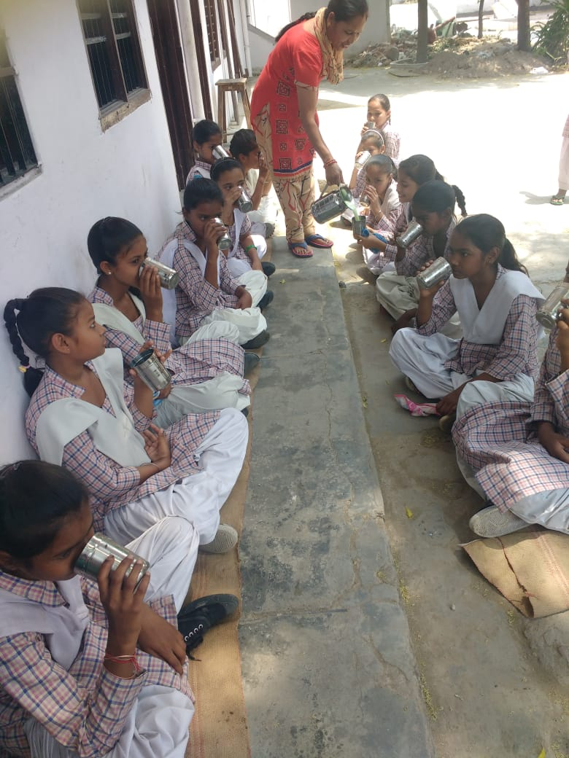
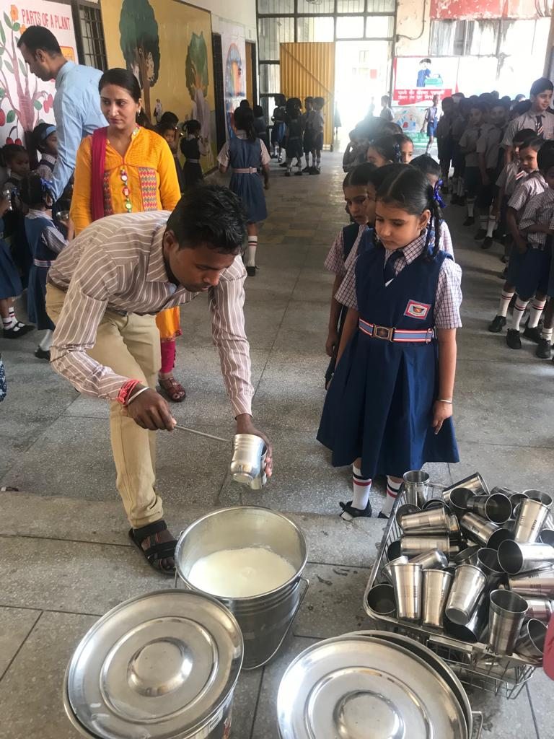
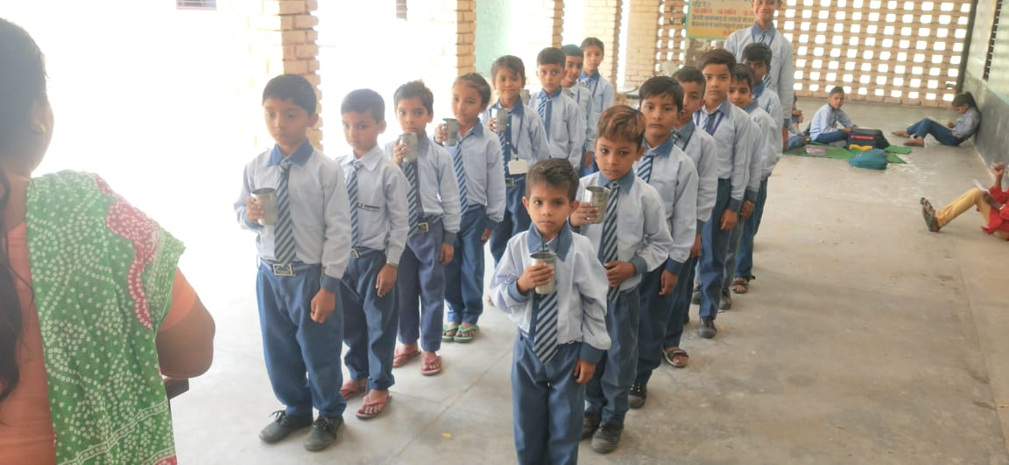
Milk Started

Slide 23
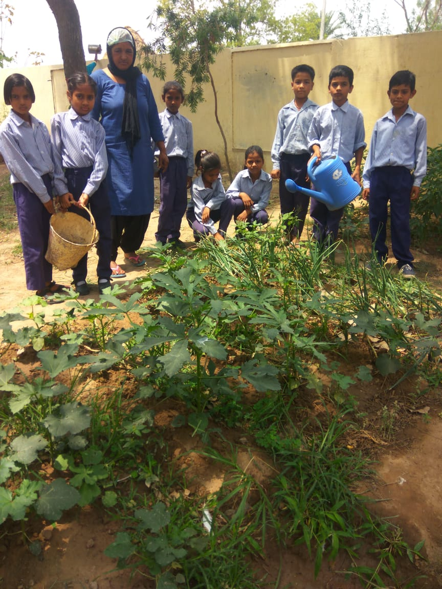
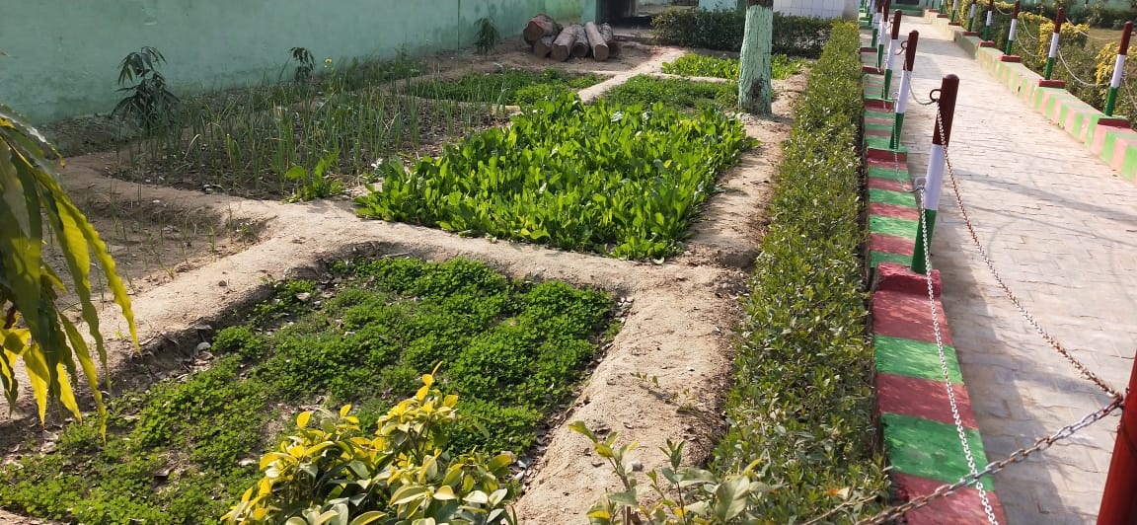
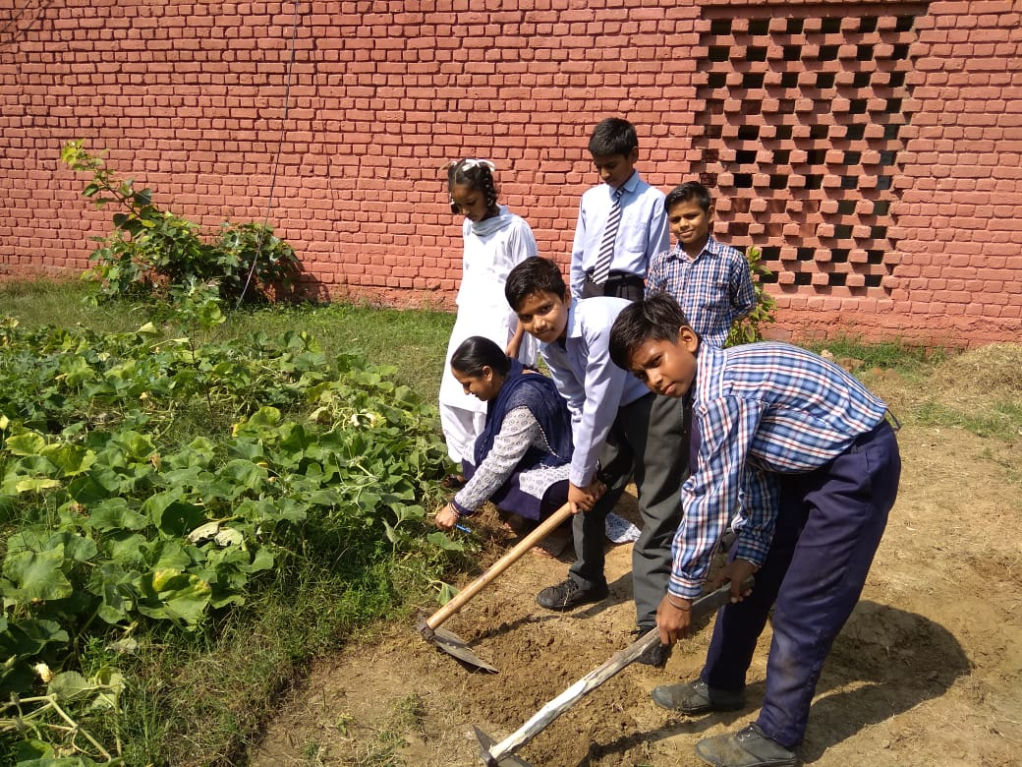
Kitchen Gardens

Slide 24
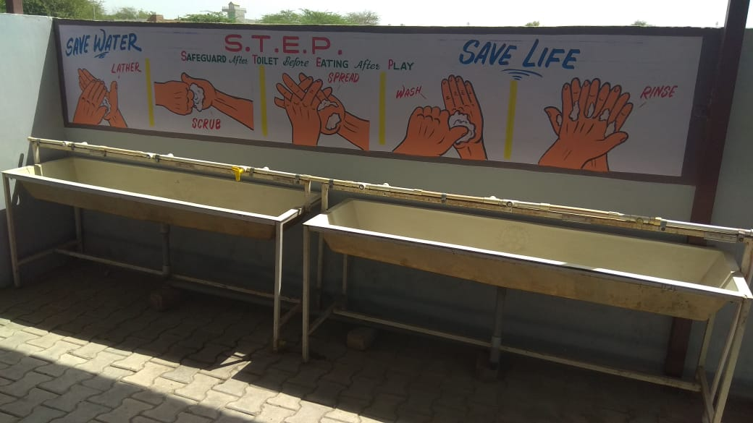
Hand wash before and after Mid Day Meal

Slide 25
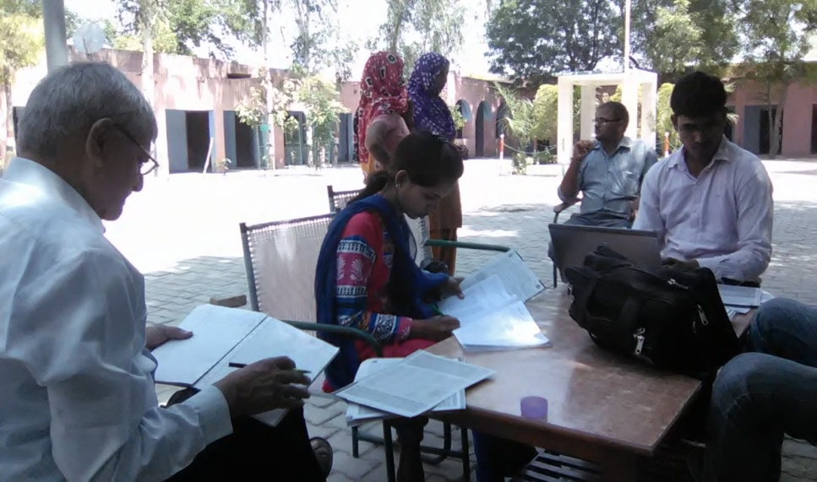
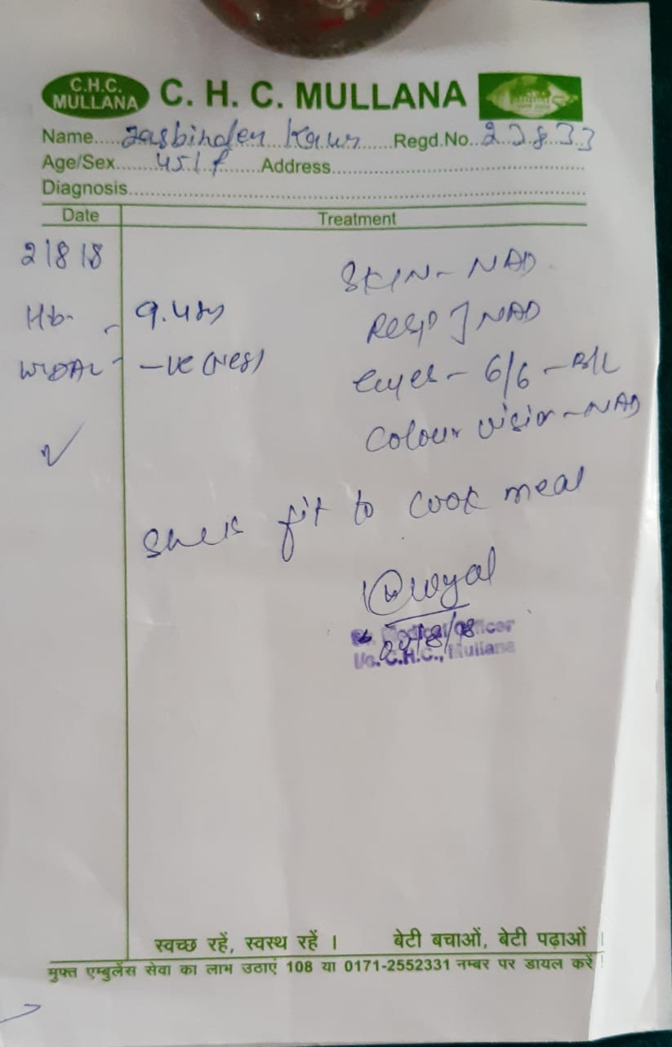
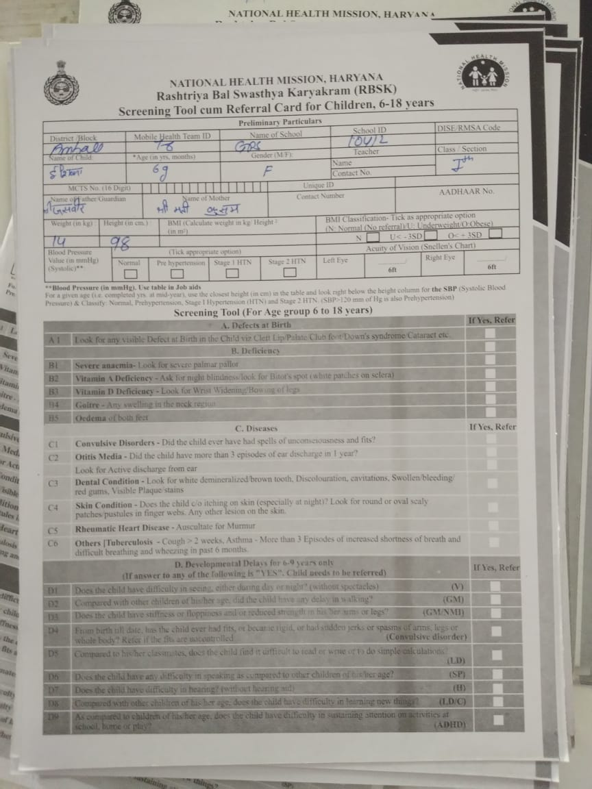
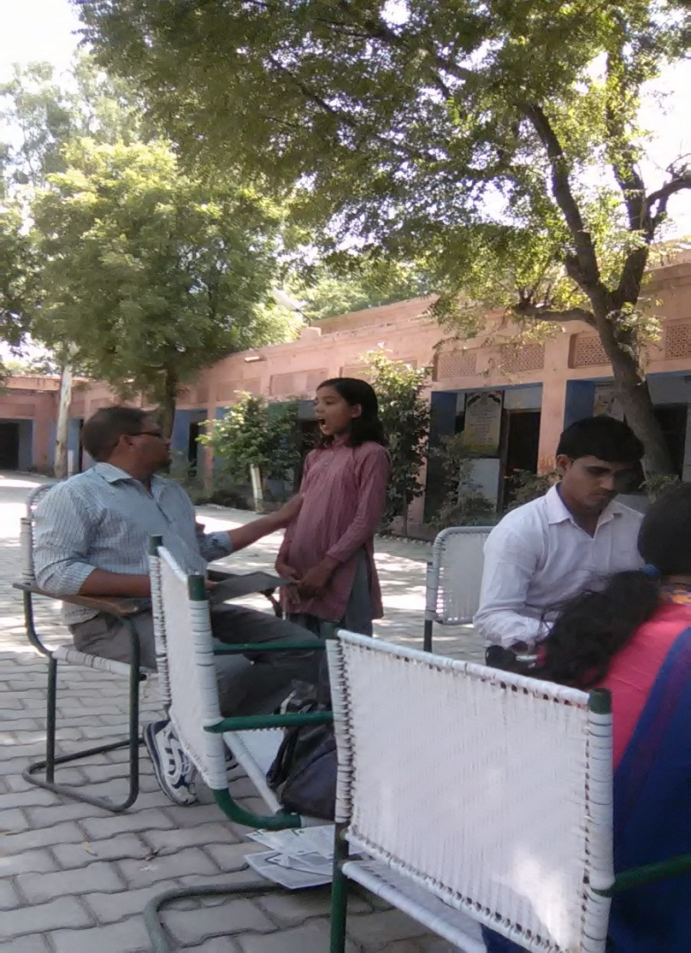
Health Check-up of Children.

Slide 26
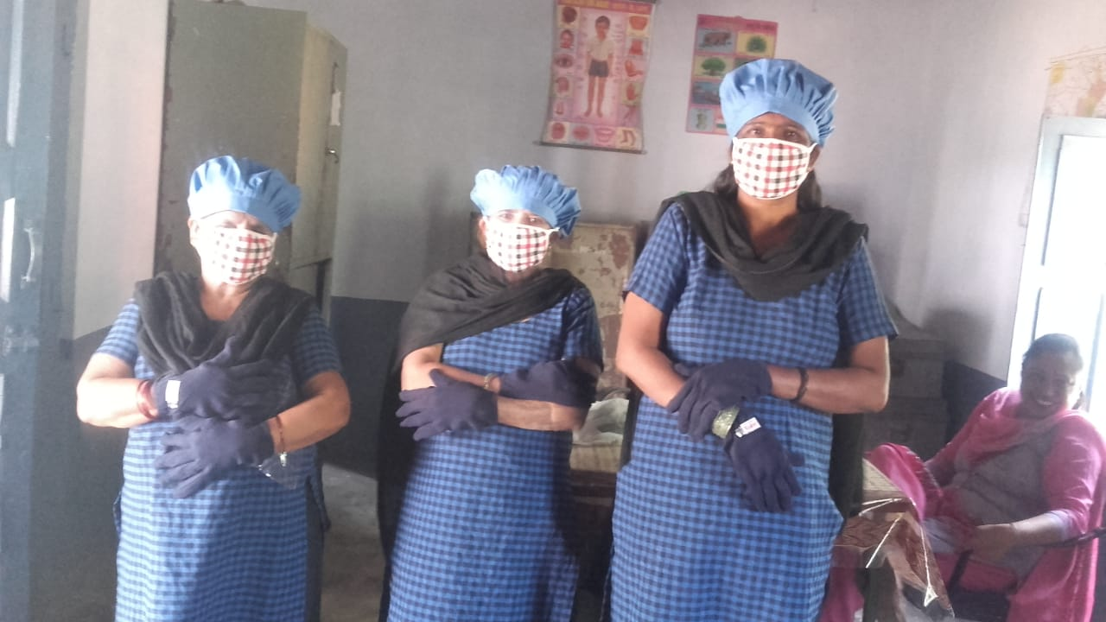
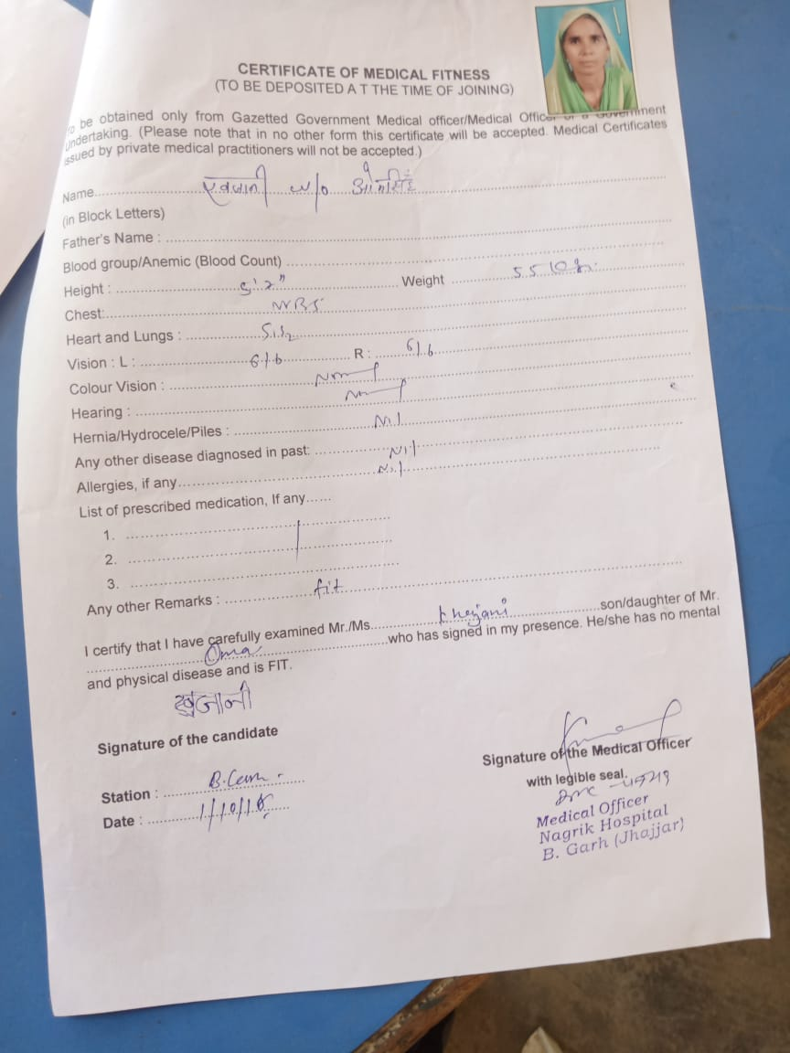
Health Check-up of Cooks and Cooks Uniform

Slide 27
School Health Programme
No of schools covered | 14390
No of childrens covered | 1491169
Iron and Folic acid supplement | 1253515
Deworming tablet | 1491169
Distribution of spectacle | 2588
In addition to this during Mid Day Meal week health check up of children done with the help of NHM.

Slide 28
Best Practices
Tithi Bhojan:-
Every 3rd Tuesday of the month is celebrated as girl student’s birthday jointly as “Beti ka Janamdin”- School Mai Abhinandan . All the girls whose birthdays fall in the given month are congratulated and given a special treatment.
It also aimed that encouraging the community participation as parents are also invited to those celebrations and are given a window of free participation in Mid Day Meal and other activities of the schools.
In Haryana State Honorarium to cooks is Rs. 3500/-per month in which Centre Share is Rs.600/- and State Share is Rs.2900/- per month against the mandatory State share of Rs. 400/- per month from 1st June 2018.
Medical examination of CCHs done once in a year.
Kitchen gardens are available in 356 schools in Haryana State .
Provision of steel thalis and spoons for children for eating MDM.
Construction of toilets for physically challenged children in Mewat district.
Availability of good quality aluminium storage bins for storing food grains

Slide 29
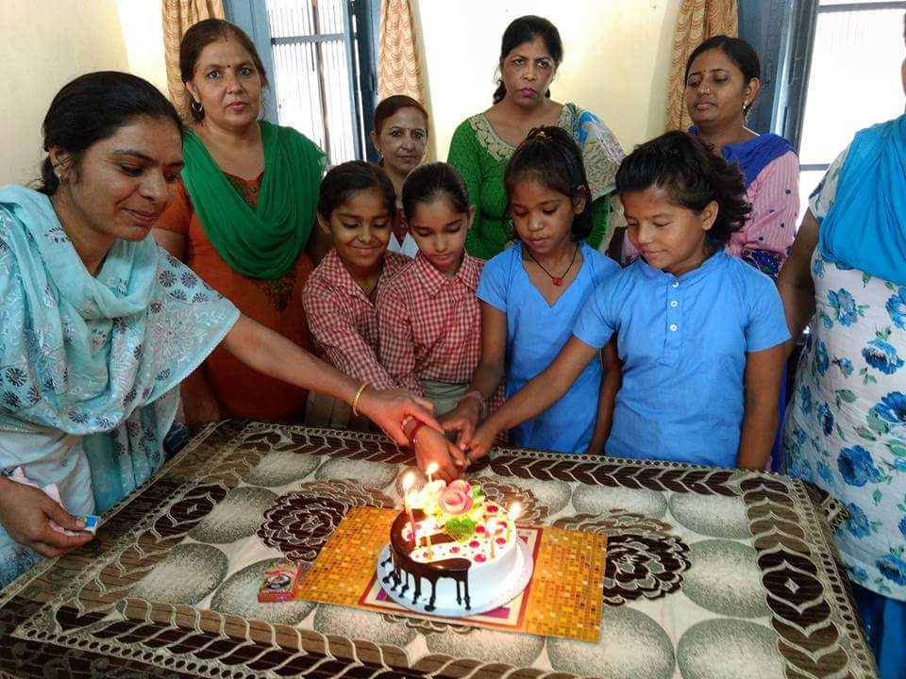
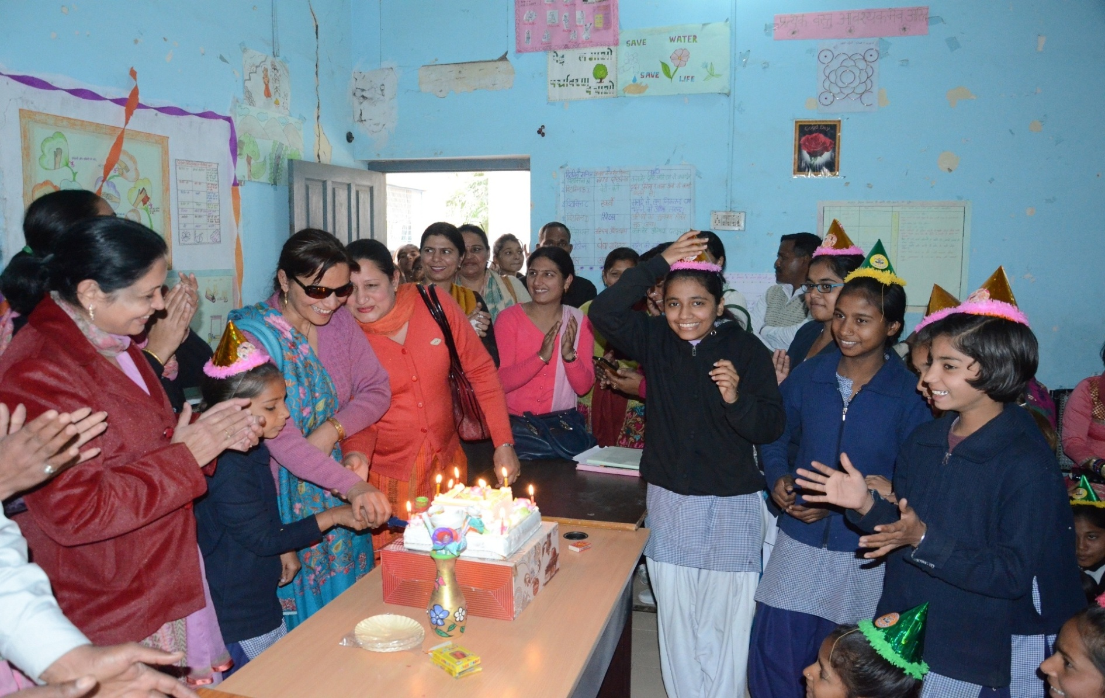
Celebration of “Beti ka Janamdin- School mai Abhinanadan”

Slide 30
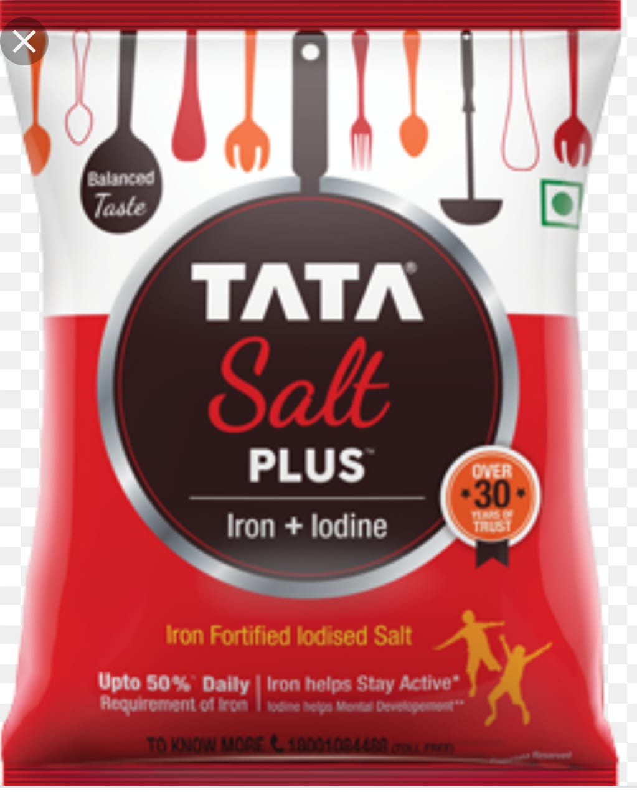
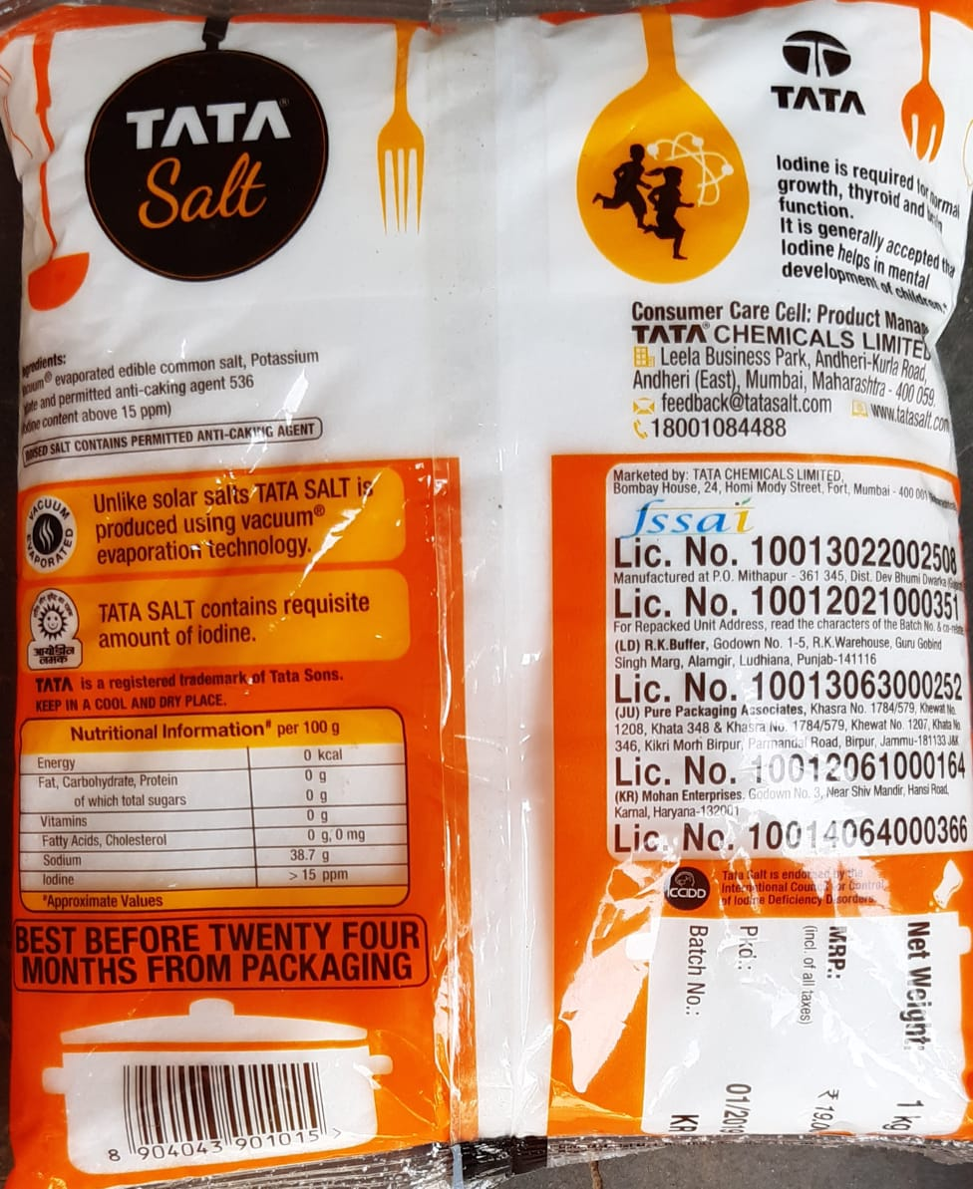
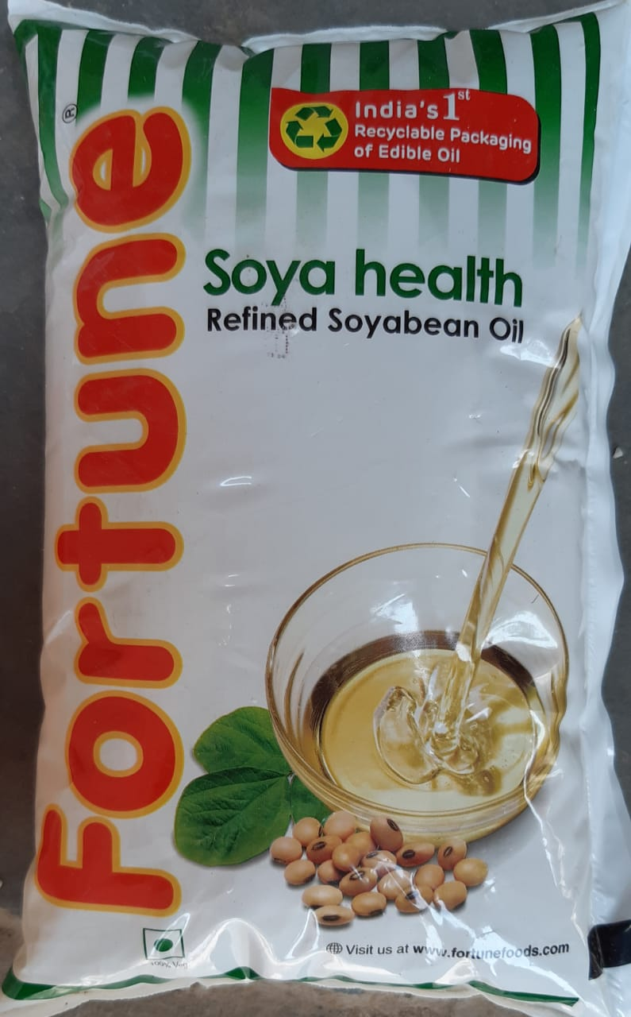
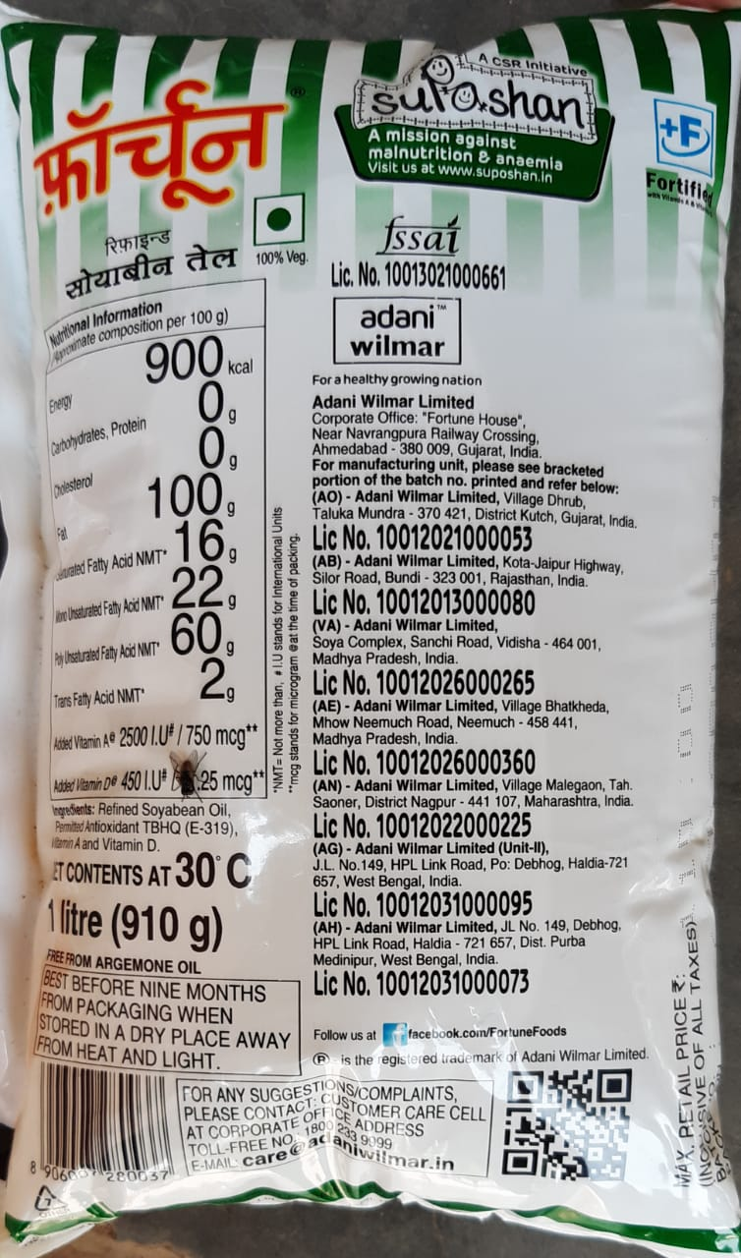
Fortified Oil and Salt

Slide 31
SECTION – V
REVIEW OF ASSURANCE GIVEN IN PAB 2018-19

Slide 32
ACTION TAKEN ON PAB ASSURANCE
Sr.No. | PAB Advice | Office Remarks
1 | To ensure e-transfer of funds to all the remaining cook cum helpers and payment of honorarium to cooks into their bank accounts | In this regard it is stated that all the cooks are being paid their honorarium through e-transfer/account payee cheques.
2 | To complete the remaining 987 kitchen cum store . | Director SSA has been requested to complete the remaining kitchen cum store up-to 31.05.2019. Constructed 10155 In progress 653 Not started 675
3 | Serving Less Quantity of Food Grain:- | In view of the said decision the said case was placed before the Hon’ble Chief Minister Haryana and the Hon’ble CM has approved the proposal made by Director Elementary Education on 28-9-2018 where in 20 recipes were approved prior to 13 recipes were given to the children. Accordingly all the DEEO’s and Director ,ISCKON have been informed vide this office letter No.1/18-2013 MDM(1) dated 16-11-2018 to make the compliance.

Slide 33
Continued…
Sr.No. | PAB Advice | Office Remarks
4 | To do the health checkup of all the enrolled children twice a year | NRHM has already been requested to do the health checkup of all the enrolled children at least Once in a year. and addition to this it has been decided to celebrate mid Day Meal Week from 5-12 September 2018. During this week medical checkup of all students & cooks has been done by NHM.
5 | To look into the issue of delay in release of fund from State to Distric/Block/School Level | During the meeting of State Level Steering cum Mointoring Committee on 19.04.2019 the Special Secretary to Govt. of Haryana Finance Department has assured that the funds during the Finance year 2019-20 will be released in time.

Slide 34
SECTION – VIII
PROPOSAL OF FUNDS FOR THE YEAR 2019-20

Slide 35
Children proposed to be covered in 2019-20
Type of School | No. of children
Primary | 810287
Upper Primary | 555980
NCLP | 2294
Total | 1368561

Slide 36
Total requirement of Budget for 2019-20
(Rs. in Cr.)
Center’s Share | State’s Share | Total
145.90 | 250.24 | 396.14

Slide 37
Component wise requirement of Budget for the Year 2019-20
(Rs.In Cr.)
Component | Centre Share | State Share | Total requirement for 2019-20
Cost of Food grains | 10.26 | 0.00 | 10.26
Transportation Cost | 6.03 | 0.00 | 6.03
Cooking Cost | 104.92 | 69.90 | 174.82
Honorarium Cook cum Helper @ Rs.3500/- per month | 18.25 | 86.50 | 104.75
Cooks Uniform | 0 | 2.00 | 2.00
Office Expenses | 0 | 0.05 | 0.05
MME | 3.77 | 0 | 3.77
Milk Provision | 0 | 90.00 | 90.00
Kitchen cum store repair(@ Rs10000/-) | 0.13 | 0.10 | 0.23
School Nutrition kitchen garden @ Rs 5000/- | 2.54 | 1.69 | 4.23
Total | 145.90 | 250.24 | 396.14

Slide 38
Requirement of Budget for the Year 2019-20(Primary Stage)
(Rs. In Cr.)
Component | Centre Share | State Share | Total requirement for 2019-20
Cost of Food grains | 5.04 | 0.00 | 5.04
Transportation Cost | 2.97 | 0.00 | 2.97
Cooking Cost | 51.60 | 34.40 | 86.00
Honorarium Cook cum Helper @ Rs. 3500 per month i.e. Rs.600/-CS &Rs.2900/- SS | 11.19 | 52.66 | 63.85
Cooks Uniform | 0 | 2.00 | 2.00
Office Expenses | 0 | 0.05 | 0.05
MME | 1.91 | 0.00 | 1.91
Kitchen cum store repair(@ Rs10000/-) | 0.0678 | 0.0452 | 0.113
Milk Provision | 0.00 | 54.00 | 54.00
School Nutrition kitchen garden @ Rs 5000/- | 1.27 | 0.85 | 2.12
Total | 74.0478 | 144.0052 | 218.053

Slide 39
Requirement of Budget for the Year 2019-20 (Upper Primary Stage)
(Rs. in Cr.)
Component | Centre Share | State Share | Total requirement for 2019-20
Cost of Food grains | 5.19 | 0.00 | 5.19
Transportation Cost | 3.05 | 0.00 | 3.05
Cooking Cost | 53.04 | 35.31 | 88.35
Honorarium Cook cum Helper @ Rs. 2500 per month i.e. Rs.600/-CS &Rs.1900/- SS | 7.06 | 33.84 | 40.90
MME | 1.85 | 0.00 | 1.85
Kitchen cum store repair(@ Rs10000/-) | .0678 | 0.0452 | 0.113
Milk Provision | 0.00 | 35.28 | 35.28
School Nutrition kitchen garden @ Rs 5000/- | 1.27 | 0.85 | 2.12
Total | 71.5278 | 105.3252 | 176.853

Slide 40
Requirement of Budget for the Year 2019-20 for (National Child Labour Project Schools(NCLP)
(Rs. in Cr.)
Component | Centre Share | State Share | Total requirement for 2019-20
Cost of Food grains | 0.03 | 0.00 | 0.03
Transportation Cost | 0.01 | 0.00 | 0.01
Cooking Cost | 0.27 | 0.20 | 0.47
MME | 0.0085 | 0.00 | 0.0085
Milk Provision | 0.00 | 0.72 | 0.72
Total | 0.3185 | 0.92 | 1.2385

Slide 41
Proposal for MME 2019-20
Sr.No | Particulars | Amount required (Rs. In Cr.)
1 | School Level Expenses | 1.03
(i) | Form & Stationery
(ii) | Training of cook cum helpers
(iii) | Replacement/repair/maintenance of cooking device, utensils, etc.
(iv) | soaps for washing hands
 | Sub Total | 1.00
2. | Management, Supervision, Training, Internal Monitoring and External Monitoring
(i) | Hiring charges of manpower at various levels | 1.90
(ii) | Transport & Conveyance | 0.10
(iii) | Office expenditure | 0.51
(iv) | Furniture, hardware and consumables etc. | 0.01
(v) | Capacity builidng of officials | 0.01
(vi) | Publicity, Preparation of relevant manuals | 0.01
(vii) | External Monitoring & Evaluation | 0.20
 | Sub Total | 3.77

Slide 42
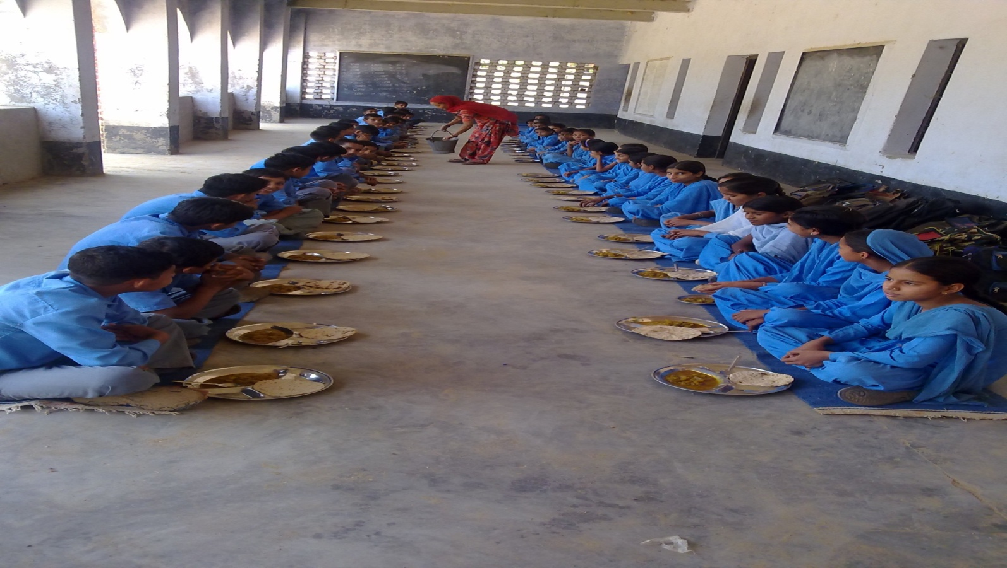
Thank You

